Slide 1
Learning Library
East Midlands Neonatal
Operational Delivery Network
An introduction to blood gases

Slide 2
Initial Discussion
What is your current knowledge of blood gasses?
Do you know what is a good result and when a result requires urgent attention?

Slide 3
Objectives
To gain a basic understanding of blood gas analysis
To be able to analyse a blood gas to determine which are: Alkalotic, Acidotic, Respiratory and/or Metabolic
To understand the difference between compensated and uncompensated gases
To be able to identify possible changes to nursing care plan based on blood gas analysis

Slide 4
What can blood gas analysis tell us?
The effectiveness of ventilation, circulation and perfusion
Changes in the level of acidity within the blood, oxygen and carbon dioxide within the blood - The way that these values change over time determine changes in medical and nursing care plans
Blood Gases tell us if the baby is able to move air in and out of the lungs well enough to obtain the oxygen it needs, and dispose of the carbon dioxide it doesn’t
Blood gases can tell us if the baby is having to use its energy stores in anaerobic metabolism

Slide 5
pH
H+ H+ H+ H+ H+ H+ H+ H+ H+ H+ H+ H+H+
H+ H+ H+
More H+ ions = lower pH (acidic)
Less H+ ions = higher pH (alkalotic)
The pH of the blood should be between
7.35 and 7.45
However, blood gas values can vary with gestational age and age of neonate.
For example a pH range of 7.25 - 7.35 may be chosen as a means of targeting ventilator support.
EMNODN Learning Library
Content provided by Rachel Cook, University Hospitals of Derby & Burton
Notes:
pH = -log(H+) : This means, each whole value below 7 is 10 times more acidic than the next higher value. So the pH scale is a wide range of the number of hydrogen ions on a much smaller, workable scale. Understanding how H+ ions effect the acidity of a solution can help us to understand the links between H+ ions, HCO3 (Bicarbonate) and CO2 (Carbon Dioxide)
Discuss blood gas ‘normal’ values can vary between clinical areas, so always check this in your own clinical area. Normal values can also vary based upon the condition of the baby eg. Prematurity.

Slide 6
Pa02 = Partial pressure of Oxygen
Pa02 is a more sensitive and accurate indicator of 02 levels in the blood than measurement of oxygen saturation (Bradshaw, Turner, Pierce, 2006)
Partial Pressure of Oxygen is measured in kilopascals (kPa)
With capillary samples, treatment decisions are not based on P02 alone, due to research which demonstrates a poor correlation between Pa02 and P02 (Durand and Boloker, 2003; American Association for Respiratory Care, 1994)
Normal Values:
Term Baby 7-12 kPA
Preterm Baby 6.5-10.5 kPA (Petty, 2013)
EMNODN Learning Library
Content provided by Rachel Cook, University Hospitals of Derby & Burton

Slide 7
PaC02 - Partial pressure of Carbon Dioxide
Blood cells produce C02 (Carbon Dioxide) as a by product of metabolism. Partial pressure of carbon dioxide is measured in Kilopascals (kPa)
Changes in pH caused by changes in C02 tension are termed respiratory (Fraser, 2012)
Normal Values:
4.6 - 6 kPA (Petty, 2013)
EMNODN Learning Library
Content provided by Rachel Cook, University Hospitals of Derby & Burton

Slide 8
Buffer Systems
Buffers are a combination of a weak acid and a strong base, which accept or release hydrogen ions to maintain acid-base balance
Primary Buffers
1. Plasma Proteins
2. Hemoglobin
3. Bicarbonate (HC03)
Bicarbonate (HC03)
EMNODN Learning Library
Content provided by Rachel Cook, University Hospitals of Derby & Burton

Slide 9
HC03
Regulated by the kidney
In Blood gas analysis, bicarbonate and base deficit / excess are used in determining the non-respiratory portion of the acid-base equation
pH changes due to a change in HCO3 are deemed Metabolic
HC0₃-
pH
Normal Values:
22-26 mmol
(Petty, 2013) (Fraser 2012)
HC0₃-
pH
EMNODN Learning Library
Content provided by Rachel Cook, University Hospitals of Derby & Burton

Slide 10
Base Excess
Base excess is the amount of acid which would have to be added to blood to correct the pH to 7.4
Normal Values: -4 - +4
A baby with a base excess below -4 is acidotic
Baby with a base excess above +4 is alkalotic
Blood gas analysis is about looking at patterns and trends
Look at results
Check previous results
Inform medical staff/senior staff nurse
EMNODN Learning Library
Content provided by Rachel Cook, University Hospitals of Derby & Burton

Slide 11
Normal Values
Neonatal (Arterial)
pH | 7.35-7.45
C02 | 4.6-6 kPA
O2 | 7-12 kPa (Term) 6.5-10.5 kPa (Preterm)
Bicarbonate | 22-26 mmol
Base Excess | Between -4 and 4
EMNODN Learning Library
Content provided by Rachel Cook, University Hospitals of Derby & Burton
(Fraser, 2012)

Slide 12
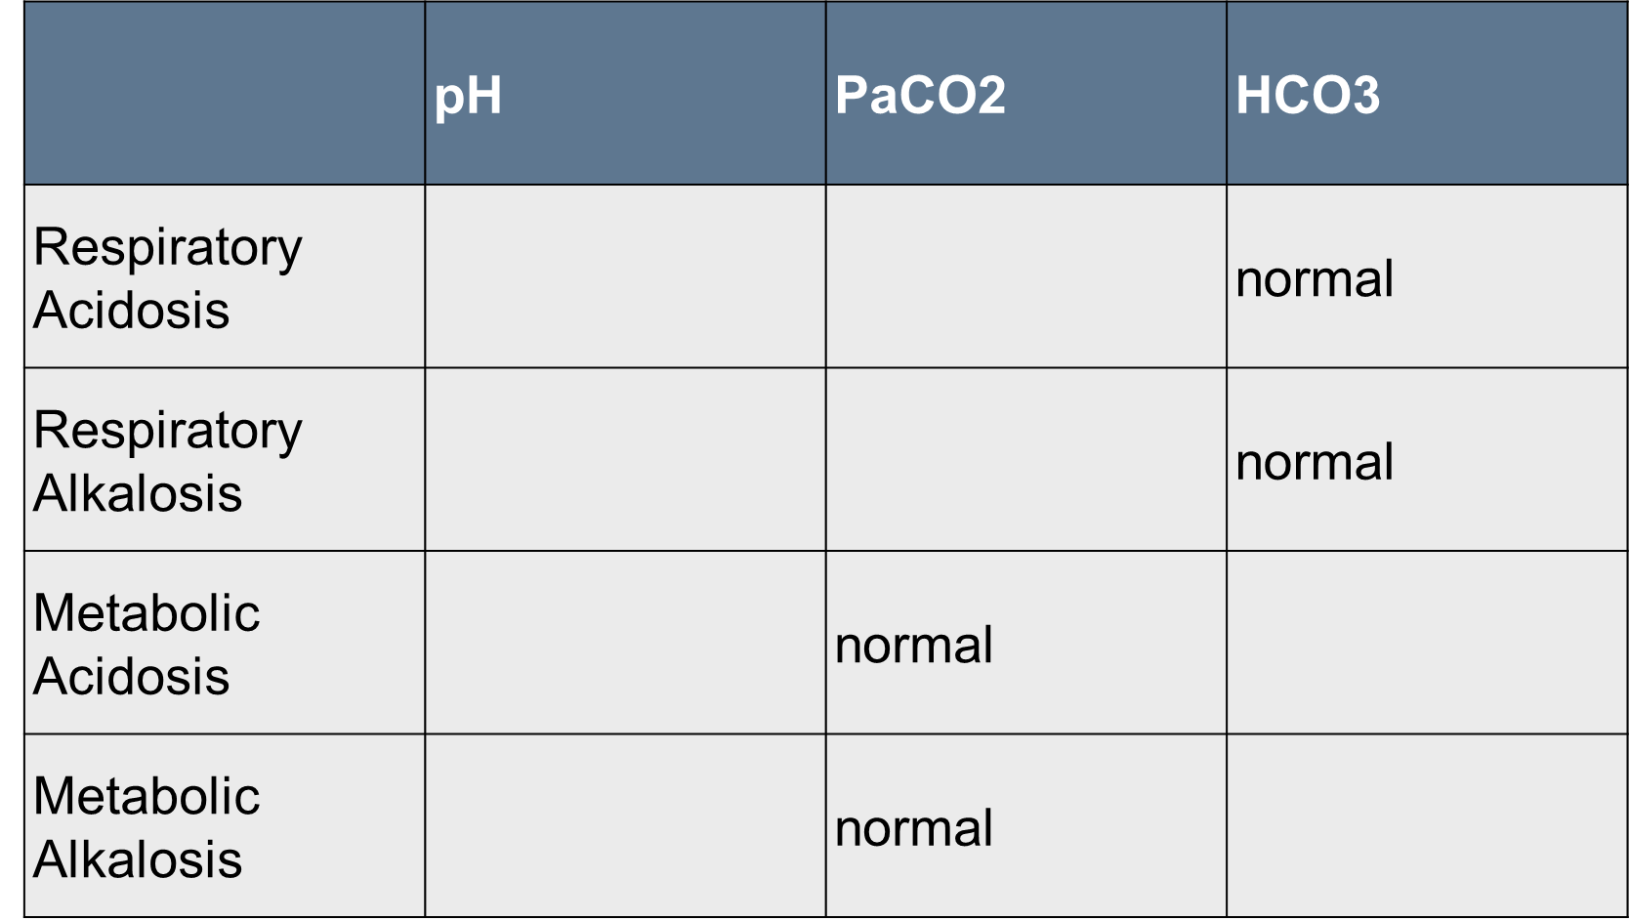
Common Abnormalities
EMNODN Learning Library
Content provided by Rachel Cook, University Hospitals of Derby & Burton

Slide 13
Compensation
Healthy lungs are able to alter Respiratory Rate or volume to regulate the amount of C02. Kidneys can retain or excrete HC03 in order to maintain blood pH.
However, the ability to compensate is limited in the neonate due to prematurity /immaturity. Compensated abnormalities might follow the patterns presented in the following table.
 | pH | PaC02 | HCO3-
Compensated Respiratory Acidosis | Normal
Compensated Respiratory Alkalosis | Normal
Compensated metabolic acidosis | Normal
Compensated metabolic alkalosis | Normal
EMNODN Learning Library
Content provided by Rachel Cook, University Hospitals of Derby & Burton

Slide 14
Respiratory Acidosis Insufficient alveolar ventilation
What could this mean?
Inability to move C02 out of lungs (Poor Ventilation)
Upper Airway Obstruction
What could we do?
Increase alveolar tension to remove C02 - this could be done using CPAP, BIPAP or mechanical ventilation.
If already on mechanical ventilation - actions could be to increase tidal volume, peak inspiratory pressure (PIP), positive end expiratory pressure (PEEP) in order to facilitate removal of C02. This decision would be made by medical staff.
EMNODN Learning Library
Content provided by Rachel Cook, University Hospitals of Derby & Burton

Slide 15
Respiratory Alkalosis Alveolar hyperventilation
What does it mean? Losing too much C02 - over ventilation.
What could be done? Change CPAP settings, reduce ventilatory support.
EMNODN Learning Library
Content provided by Rachel Cook, University Hospitals of Derby & Burton

Slide 16
Metabolic Acidosis
Deficiency of HC0₃-
What does it mean?
Loss of HC0₃, Anaerobic metabolism
What could be done?
Minimise the risk of anaerobic metabolism, correct cause. ?Sodium Bicarbonate if >-10
EMNODN Learning Library
Content provided by Rachel Cook, University Hospitals of Derby & Burton

Slide 17
Metabolic Alkalosis
What does it mean?
Too much Sodium Bicarbonate. ?Loss of H+ (vomiting)
What could we do?
Correct cause eg. Reduce diuretics
EMNODN Learning Library
Content provided by Rachel Cook, University Hospitals of Derby & Burton

Slide 18
Points for Consideration
Poorly perfused baby when taking capillary samples will affect results
Beware of air Bubbles in capillary tubes!
Look at trends - if incalculable or very different to previous results, does the gas need to be repeated?
How often does the neonate need blood gases?
Vaseline should not be used to take blood gases as it can alter the results
Blood gas normal values are approximate values, the overall condition of the baby will also assist with changes in care (Durand and Phillips, 1996)
Blood gas accepted normal values will vary from unit to unit
EMNODN Learning Library
Content provided by Rachel Cook, University Hospitals of Derby & Burton

Slide 19
Infant born at 32/40 presenting with grunting and subcostal/intercostal recession. RR 80, Heart Rate 170, Temperature 36.5. Capillary Sample.
pH 7.28
P02 5 kPA
PC02 9 kPA
HC03 24 mmols
BE +2
Example 1
EMNODN Learning Library
Content provided by Rachel Cook, University Hospitals of Derby & Burton
Notes:
Respiratory Acidosis: Increased respiratory rate, signs of respiratory distress. pH less than 7.35 -> Acidotic, PC02 high, respiratory problem. HCO3 normal. BE normal. We would need to improve alveolar ventilation. Does the baby need a chest X-Ray? CPAP? When does the blood gas need repeating? At least 20-30 minutes after any change in ventilation.

Slide 20
Example 1 Answer
Respiratory Acidosis:
Increased respiratory rate, signs of respiratory distress. pH less than 7.35 Acidotic, PC02 high, respiratory problem. HCO3 normal. BE normal.
We would need to improve alveolar ventilation. The baby could benefit from a chest x-ray if the symptoms persist beyond a few hours. Otherwise, close observation and nursing the baby prone while monitored, could relieve the symptoms. Blood gases should be repeated 20-30 minutes after changing ventilation.
EMNODN Learning Library
Content provided by Rachel Cook, University Hospitals of Derby & Burton

Slide 21
Example 2
A 28 week old infant is receiving SIMV ventilation for respiratory distress syndrome at a rate of 40, PIP 20, PEEP 4, in 30-35 O2. Arterial Blood Gas:
pH 7.48
pa02 13
pC02 3
HCO3 22
BE +2
EMNODN Learning Library
Content provided by Rachel Cook, University Hospitals of Derby & Burton
Notes:
pH elevated, alkalosis -> pC02 low -> p02 high. HCO3 base excess normal.
Respiratory Alkalosis - what actions could be taken?
Rate could be reduced, tidal volume. Wean oxygen as able to remain within target saturations.

Slide 22
Example 2 Answer
pH elevated, alkalosis, pC02 low, p02 high. HCO3 base excess normal.
Respiratory Alkalosis - what actions could be taken?
Rate could be reduced, tidal volume. Wean oxygen as able to remain within target saturations
EMNODN Learning Library
Content provided by Rachel Cook, University Hospitals of Derby & Burton

Slide 23
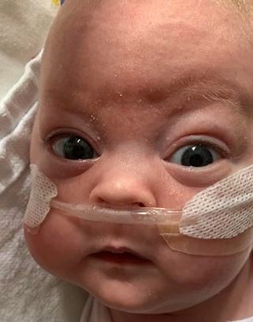
Example 3
Baby C born at 30/40, on day 50 is cycling 6 hours on, 6 hours off CPAP. Whilst on, between 25 and 30% oxygen. Whilst off, in NP02 between 0.05 and 0.08 lpm. Capillary Blood gas results are as follows:
pH 7.32
PC02 9
p02 6
HCO3 30
BE 1
EMNODN Learning Library
Content provided by Rachel Cook, University Hospitals of Derby & Burton
Notes:
Compensated respiratory acidosis - pH is within normal range for a preterm baby, PC02 elevated, p02 low, HCO3 elevated, BE normal.

Slide 24
Example 3 Answer
Compensated respiratory acidosis - pH is within normal range for a preterm baby, PC02 elevated, p02 low, HCO3 elevated, BE normal
EMNODN Learning Library
Content provided by Rachel Cook, University Hospitals of Derby & Burton

Slide 25
References
American Association for Respiratory Care (1994) AARC clinical practice guideline: Capillary blood gas sampling for neonatal and paediatric medicine. Respiratory Care 39(1): pp.1180-1183.
Bradshaw, WT., Turner, BS., Pierce, JR. (2006) Physiologic monitoring. Handbook of Neontal Intensive Care (6th ed.) Philadelphia: Mosby.
Durand, DJ., Philips, BL., Boloker, J. (2003) Blood gases: Technical aspects and interpretation. In Assisted Ventilation of the Neonate (4th ed.) Goldsmith, JP., Karotkin, EH, eds. Philadelphia: Saunders.
Fraser, D. (2012) Acute Respiratory Care of the Neonate (3rd ed) California: NICU Inc Book Publishers.
Petty, J. (2013) Understanding neonatal ventilation strategies for decision making in the NICU. Neonatal Network 32(4): 246-261.
EMNODN Learning Library
Content provided by Rachel Cook, University Hospitals of Derby & Burton

Slide 26
Acid/base metabolism is regulated by this equation
Bicarbonate is naturally produced by the reaction of Carbon Dioxide and Water to make H2CO3 (Carbonic Acid) which dissociates to a bicarbonate ion and Hydrogen ions.
EMNODN Learning Library
Content provided by Rachel Cook, University Hospitals of Derby & Burton
Notes:
This equation demonstrates the links between pH (number of hydrogen ions), CO2 and HCO3.

