Slide 1
Learning Library
East Midlands Neonatal
Operational Delivery Network
Promoting Normothermia from Delivery to Admission to the Neonatal Unit
EMNODN Learning Library
Content provided by Rachel Cook, University Hospitals of Derby & Burton

Slide 2
Learning Objectives
To define ‘Normothermia’ for sick and premature neonates
To consider methods of heat production and loss in newborn infants
To consider the nursing role in promoting a neutral thermal environment for sick and premature neonates
EMNODN Learning Library
Content provided by Rachel Cook, University Hospitals of Derby & Burton
"Ariel" by TaylorErinn is licensed under CC BY-NC-ND 2.0
Notes:
Outline of the Session: 10 minute session, look at defining a ‘normal temperature’, consider methods of heat production and loss, consider the nursing role. Opportunity to ask questions at the end, before summarise.

Slide 3
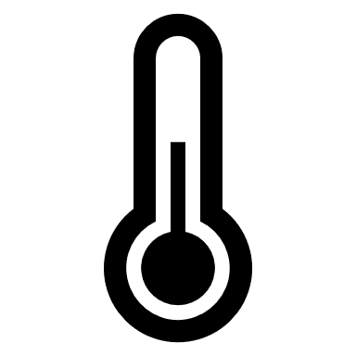
What temperature are we aiming for?
36℃
36.5℃
37℃
37.5℃
38℃
Hypothermia:
Core body temperature of less than 36.5ºC
Surface <36ºC (1)
Hyperthermia:
>38ºC (2)
How do we measure? Thermometer - Axilla, Skin probe (abdomen)
EMNODN Learning Library
Content provided by Rachel Cook, University Hospitals of Derby & Burton
Notes:
Resuscitation Council guidance and the National Neonatal Audit Programme (NNAP) recommend a target temperature range of 36.5 and 37.5, through stabilisation and admission.
Hyperthermia: Normal fetal temperature 37.5 and may increase during labour, so may not be easy to modify from birth.
Focus more on hypothermia during this presentation
Temperature regulation fundamental to neonatal care.
Body temperature maintained through increased energy expenditure or a neutral thermal environment. We are aiming for a Thermoneutral environment where baby is neither gaining or losing heat .

Slide 4
Why do neonates get cold?
All Babies
In utero temperature 37℃
Wet
Bare skin
Large surface area relative to body mass
Inability to shiver
Premature Babies
Poor Muscle Tone
Skin - increased heat and water losses
↓Subcutaneous Fat for insulation
↓Brown Adipose Tissue
↓Oxygen capacity to utilise brown adipose tissue (Lyon et al., 1997)
EMNODN Learning Library
Content provided by Rachel Cook, University Hospitals of Derby & Burton

Slide 5
What effect does hypothermia have on the neonate?
Increased Metabolism - ↑Oxygen Consumption ↑Glucose Uptake
Use of Brown Fat - Metabolic Acidosis
Peripheral and pulmonary vasoconstriction - ↓ Oxygen and Perfusion
Poor weight gain
Increased Mortality
(Lissauer, Fanaroff, Miall et al., 2016)
EMNODN Learning Library
Content provided by Rachel Cook, University Hospitals of Derby & Burton
How do they lose heat?
Notes:
Look at triangle and reference
Increased Metabolism - Reduced oxygen consumption and increased glucose uptake.
If Oxygen consumption is increased, work of breathing increases, baby can go in to anaerobic respiration, have problems with hypoxia.
If increased glucose uptake, increased use of glycogen stores leading to Hypoglycaemia.
If Brown fat is metabolised for warmth, release of fatty acids, reduced surfactant production and pulmonary vasoconstriciton.

Slide 6
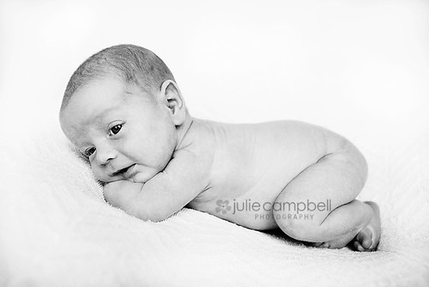
Methods of Heat Loss: Evaporation
Loss of moisture and heat from warm, wet skin
Evaporation -> Conduction -> Convection ->Radiation
Term - Dry in pre-warmed towel, remove wet towel, wrap in warm towel
Term and preterm - Hat
Preterm - plastic Bag <30 weeks, <1.4 kg
Preterm - Transepidermal water loss - reduced by humidity
EMNODN Learning Library
Content provided by Rachel Cook, University Hospitals of Derby & Burton
"Newborn" by juliecampbell is licensed under CC BY-NC-ND 2.0
Notes:
Through understanding the methods of heat loss, we can begin to consider how we can prevent them.
Transepidermal water loss - increased in very premature infants, increased by radiant warmers, reduced by humidity.

Slide 7
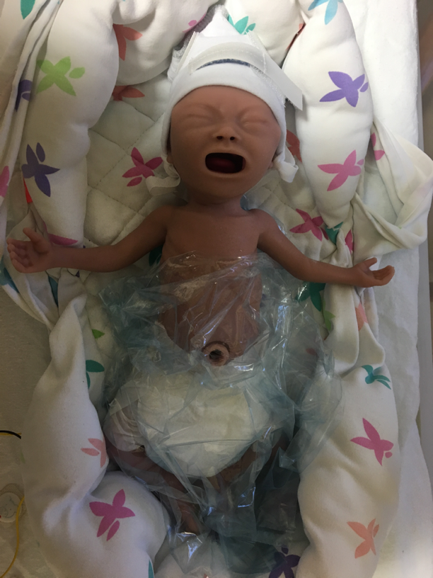
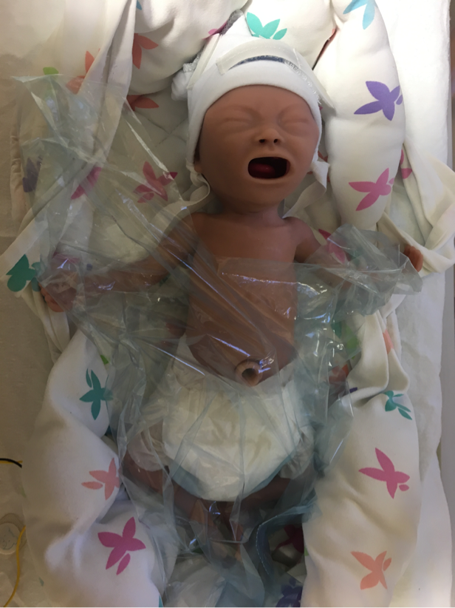
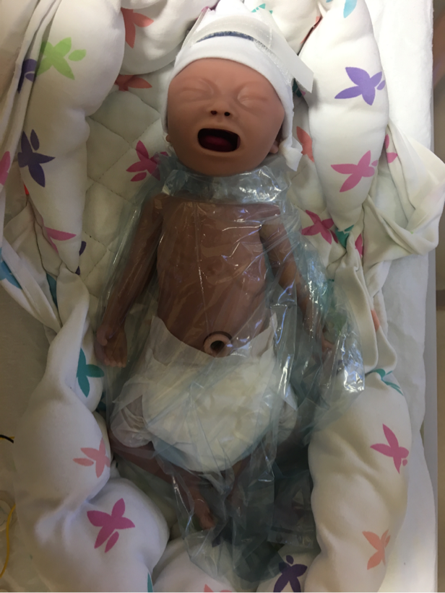
What is the correct position of the plastic bag?
a
b
c
EMNODN Learning Library
Content provided by Rachel Cook, University Hospitals of Derby & Burton

Slide 8
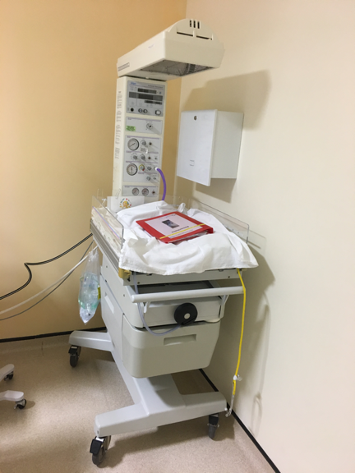
Methods of Heat Loss: Conduction
Heat loss due to direct contact with cooler surfaces
Evaporation -> Conduction -> Convection ->Radiation
Pre-warm Resuscitaire
Transwarmer - Safety Alert
EMNODN Learning Library
Content provided by Rachel Cook, University Hospitals of Derby & Burton
Notes:
Through understanding the methods of heat loss, we can begin to consider how we can prevent them.
Transepidermal water loss - increased in very premature infants, increased by radiant warmers, reduced by humidity.

Slide 9
Methods of Heat Loss: Convection Heat loss due to cooler, circulating air, particularly in the context of open windows and doors
Evaporation -> Conduction -> Convection ->Radiation
Room Temperature at delivery 26℃ (BAPM, 2005)
Clothing infant on admission to neonatal unit (if term baby and not in incubator)
Avoiding draughts
EMNODN Learning Library
Content provided by Rachel Cook, University Hospitals of Derby & Burton
Notes:
Through understanding the methods of heat loss, we can begin to consider how we can prevent them.
Transepidermal water loss - increased in very premature infants, increased by radiant warmers, reduced by humidity.

Slide 10
Methods of Heat Loss: Radiation Non direct transfer of heat to cooler mediums – difference between skin and surrounding surfaces
Evaporation -> Conduction -> Convection ->Radiation
Radiant Heat Source
Independent of air temperature
Double walled incubator on admission to the neonatal unit
EMNODN Learning Library
Content provided by Rachel Cook, University Hospitals of Derby & Burton
Notes:
Through understanding the methods of heat loss, we can begin to consider how we can prevent them.
Transepidermal water loss - increased in very premature infants, increased by radiant warmers, reduced by humidity.

Slide 11
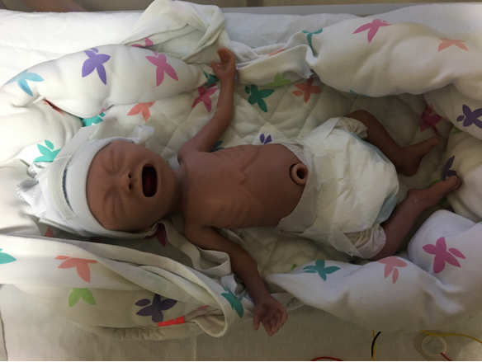
Example 1 Which of the following temperature control measures would you consider?
Baby A – Preterm, born at 28 weeks gestation, growth restricted, weighs 880grams. Born in theatre via c-section
Plastic bag at delivery
On rescuscitaire under radiant heater at delivery
Pre warmed, humidified incubator ready on neonatal unit
Ensure delivery room at 26ºC
Dry in warm towel, remove wet towel and wrap in warm towel
Transwarmer
Skin to skin with parent
Hat
Ensure no draughts in room
Minimal handling where possible (after initial lines etc)
EMNODN Learning Library
Content provided by Rachel Cook, University Hospitals of Derby & Burton

Slide 12
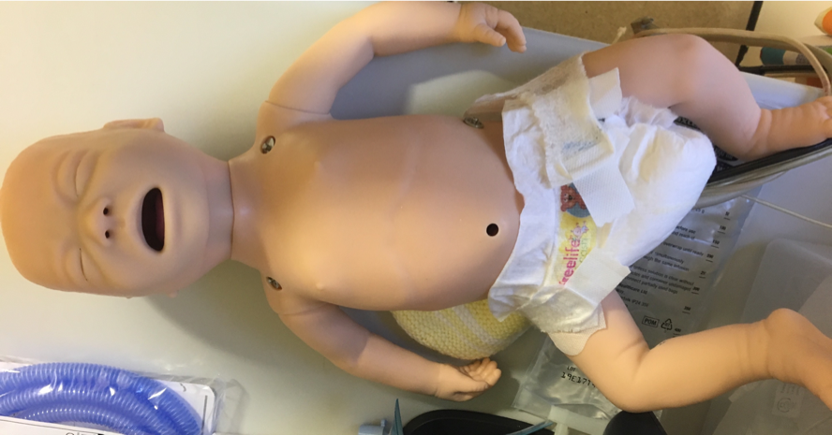
Example 2 Which of the following actions could you consider to promote ‘normothermia’?
Baby B – Term, weighs 3kg, cried at birth with no signs of respiratory distress
Plastic bag at delivery
On rescuscitaire under radiant heater at delivery
Pre warmed, humidified incubator ready on neonatal unit
Ensure delivery room at 26ºC
Dry in warm towel, remove wet towel and wrap in warm towel
Transwarmer
Skin to skin with parent
Hat
Ensure no draughts in room
EMNODN Learning Library
Content provided by Rachel Cook, University Hospitals of Derby & Burton

Slide 13
Summary
Normothermia - 36.5-37.5℃
All babies are vulnerable to becoming cold - preterm babies even more so
Methods of Heat Loss: Evaporation,
Conduction,
Convection,
Radiation
EMNODN Learning Library
Content provided by Rachel Cook, University Hospitals of Derby & Burton
"Bath time" by Q, A, O, P, Space is licensed under CC BY-NC-SA 2.0
Notes:
Summary: Today we have established the ‘normothermic’ range, and looked at the problems for term and preterm babies if their temperature falls out of that range. We have considered how, through understanding the methods of heat loss, we can prevent them. This knowledge of the methods of heat loss can also inform our practice of how we can continue to maintain a neutral thermal environment for neonates throughout their stay on NICU. If anyone would like any further information on how hypothermia links with hypoglycaemia and hypoxia there are some really interesting articles in the further reading.

Slide 14
References and Further Reading
World Health Organisation (WHO) (1997). Maternal and Newborn Health/Safe Motherhood. Thermal protection of the newborn: a practical guide. Geneva: WHO. [online] Available at: https://apps.who.int/iris/bitstream/handle/10665/63986/WHO_RHT_MSM_97.2.pdf?sequence=1 Accessed 4th December 2019.
Lyu, Y., Shah, PS., Ye, XY., et al. (2015) Canadian Neonatal Network. Association between admission temperature and mortality and major morbidity in preterm infants born at fewer than 33 weeks' gestation. JAMA Pediatr. 169(4):e150277. doi: 10.1001/jamapediatrics.2015.0277.
Aylott, M. (2006) The neonatal energy triangle. Part 1:Metabolic adaptation Paediatric Nursing 18(6): pp. 38-42
Aylott, M. (2006) The neonatal energy triangle. Part 2:Thermoregulatory and respiratory adaptation Paediatric Nursing 18(7): pp. 38-42
Lyon, AJ., Pikaar, ME., Badger, P et al (1997) Temperature control in infants less than 100g birthweight in the first 5 days of life. Archives of Disease in Childhood. 76(1): F47-50.
Lissauer, T., Fanaroff, A., Miall, L., Fanaroff, J. (2016) Neonatology at a Glance (Third edition) West Sussex: John Wiley and Sons, Ltd.
EMNODN Learning Library
Content provided by Rachel Cook, University Hospitals of Derby & Burton

