Slide 1
Learning Library
East Midlands Neonatal
Operational Delivery Network
Pain Management
EMNODN Learning Library
Content provided by Kate Twigger, Kettering General Hospital

Slide 3
Pain Policy
What should be included in your pain policy:
The N-PASS assessment tool
Encouraging parents involvement into pain management
Scoring pain on the assessment and observation charts
Including pain assessment on the ward round and adding it to the medical daily ward round documentation
Using all non-pharmaceutical approaches to managing pain
EMNODN Learning Library
Content provided by Kate Twigger, Kettering General Hospital

Slide 4
The N-PASS Tool
EMNODN Learning Library
Content provided by Kate Twigger, Kettering General Hospital

Slide 5
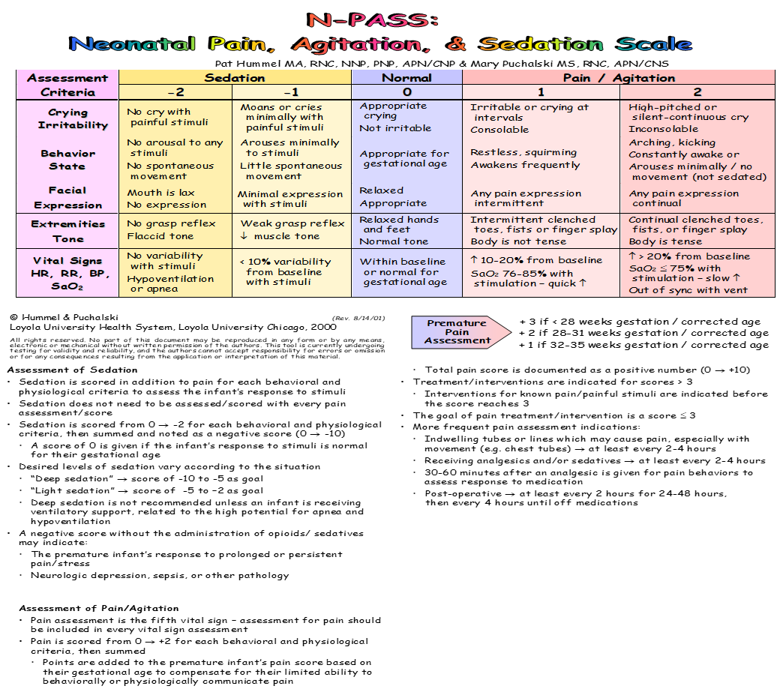
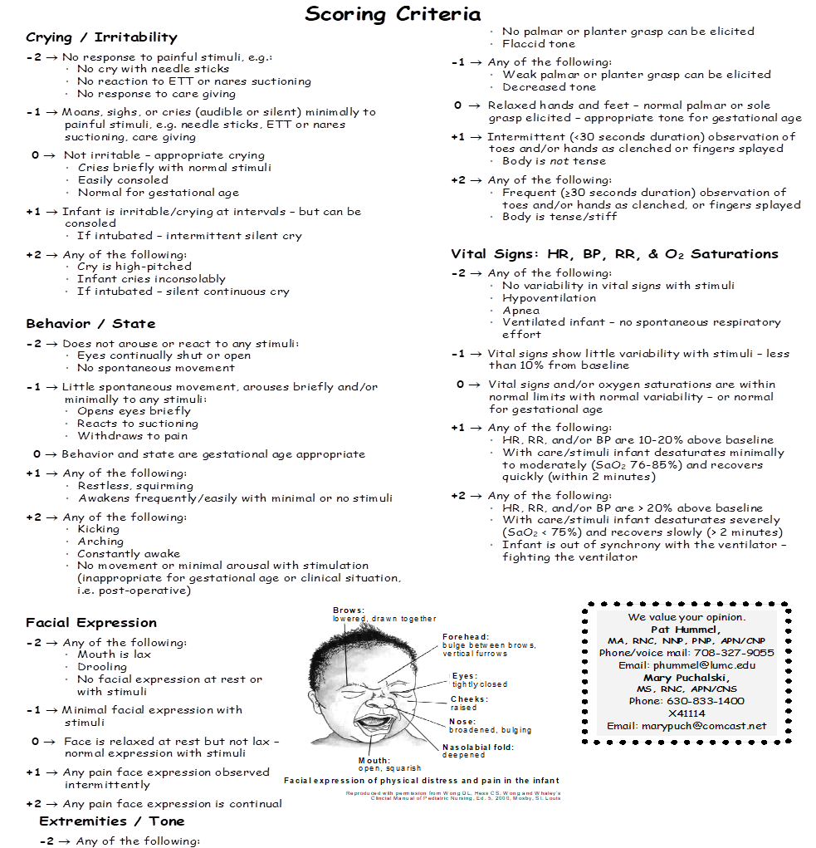

Slide 6
Main Points from N-PASS Tool
Scoring for pain is out of 13 (the score can be increased by clinical assessment and include interventions for example NGT)
Intervention should be considered with a score of above 3
Sedation scoring is -10 being heavily sedated and 0 being not sedated or “normal”
We should be following the scoring guidelines for the appropriate gestation
Review effectiveness of pain relief after 30-60 minutes and documenting the new score
Reviewing the 5 areas (vital signs, behavioral, facial expression, crying/irritability and extremities/tone) to ensure an adequate pain assessment has taken place
EMNODN Learning Library
Content provided by Kate Twigger, Kettering General Hospital

Slide 7
When to assess pain
On admission to the neonatal unit
At shift changes
At any point during a shift if the nurse or parent considers it necessary
Pre and post invasive procedures
Four hourly/as required if the infant is receiving analgesic support
30-60 minutes after analgesia or comfort measure is administered to assess the effectiveness of the intervention
Increase assessment frequency if the neonate has any indwelling tubes or lines which could cause pain especially with movement for example a chest drain
EMNODN Learning Library
Content provided by Kate Twigger, Kettering General Hospital

Slide 8
EMNODN Learning Library
Content provided by Kate Twigger, Kettering General Hospital

